Slide 1
NTI · AWS SOLUTIONS ARCHITECT · GRADUATION TRACK
Lumina Dental
Deploying a scalable, highly available web application on AWS
EC2 · Auto Scaling · Application Load Balancer · RDS PostgreSQL · CloudFront · WAF
Benha University
Faculty of Engineering in Shoubra
Department of Communication and Electronics
Third academic year
Presented by
Zeyad Bilal Gamal
Training course: NTI - AWS Solutions Architect
Notes:
Introduce the project: a real dental-clinic web application deployed on AWS as a scalable, highly available architecture.

Slide 2
1
Project objective
What problem the deployment had to solve
The application a Next.js frontend, a FastAPI backend and a PostgreSQL database originally ran on one single server. The objective was to redeploy it on AWS so that it keeps running when a server fails, grows with demand, and exposes only one controlled entry point to the internet.
BEFORE
AFTER
One server does everything
A layered, multi-AZ architecture
Frontend, backend and database on the same EC2 instance
The server is a single point of failure
Growth means manually building a bigger server
The database and SSH port are exposed to the internet
Two or more stateless servers across two Availability Zones
A load balancer is the only public entry point
Capacity grows and shrinks automatically with demand
The database is private, managed, and replicated
Lumina Dental · NTI AWS Solutions Architect
1
Notes:
The core idea: move from one machine that does everything to separate layers, each of which can fail or scale on its own.

Slide 3
2
Why this design matters
Five properties the architecture was built to deliver
1
High availability
2
Scalability
3
Security in depth
Minimum of two instances across two Availability Zones, plus a standby database. Losing one server or one zone is not an outage.
The Auto Scaling Group adds instances from 2 up to 6 when CPU rises, and removes them when it falls. No manual work.
Compute and database live in private subnets. Only the load balancer is public, and WAF inspects every request before it arrives.
4
Observability
5
Operability
6
Cost awareness
Seven CloudWatch alarms across the scaling group, load balancer, target group and database, all sending email through SNS.
Instances are disposable: built from one Golden AMI, replaced automatically, and reachable through Session Manager without SSH.
A maximum of six instances puts a ceiling on spend, and every fixed cost in the design buys a specific availability guarantee.
7
Performance
CloudFront caches static assets, reducing latency for users and decreasing the number of requests reaching the origin.
Lumina Dental · NTI AWS Solutions Architect
2
Notes:
These six properties are the reason for every service choice that follows.

Slide 4
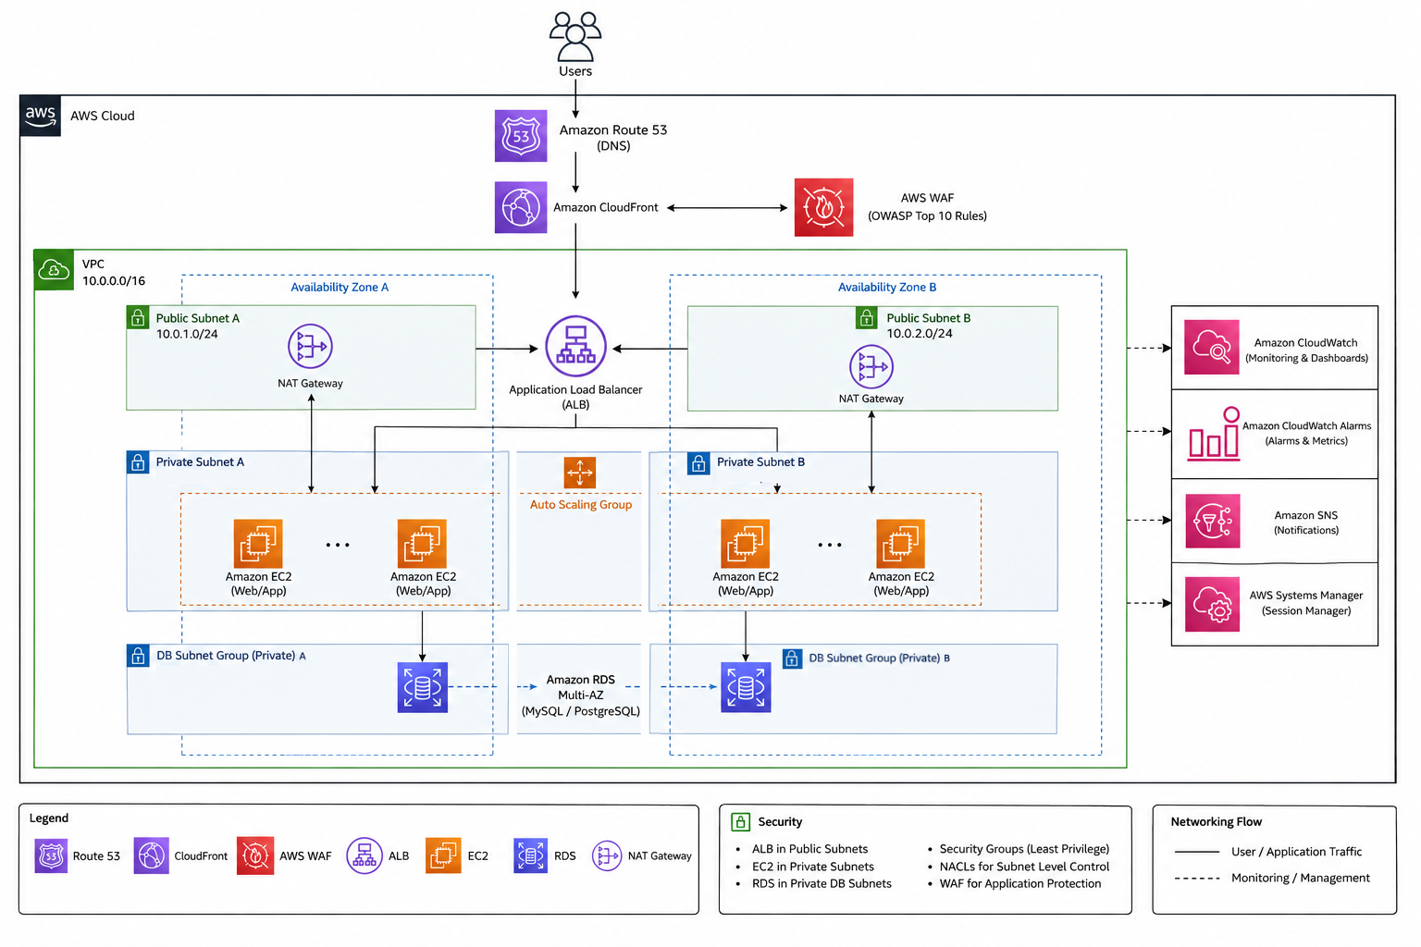
3
The architecture at a glance
Edge services, a two-zone VPC, and three subnet tiers
READING THE DIAGRAM
Users reach CloudFront, where WAF inspects the request
The Application Load Balancer is the only public entry point
EC2 instances run in private subnets in two Availability Zones
RDS sits in isolated database subnets with no internet route
NAT Gateways give instances outbound access only
CloudWatch, SNS and Systems Manager sit outside the traffic path
Lumina Dental · NTI AWS Solutions Architect
3
Notes:
Walk left to right: edge, then the VPC, then the three tiers inside each Availability Zone.

Slide 5
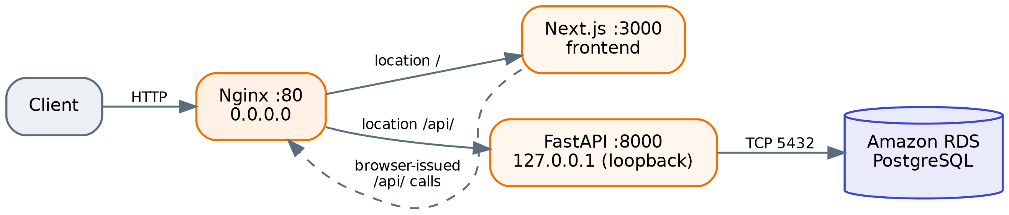
4
The application on each instance
One public port, three internal services
Nginx :80
Next.js :3000
FastAPI :8000
The only process listening on the network. It receives every request and decides where it goes.
Serves the pages. Requests to / are proxied to it internally.
Bound to 127.0.0.1, so it cannot be reached from outside the instance at all. Requests to /api/ are proxied to it.
Lumina Dental · NTI AWS Solutions Architect
4
Notes:
Because the backend is bound to loopback, ports 3000 and 8000 are never exposed — the whole application is published on port 80 through Nginx.

Slide 6
5
Amazon EC2 and the Golden AMI
Building one validated server, then cloning it
WHAT I IMPLEMENTED
WHY I CHOSE THIS SERVICE
Configured one t3.small instance with Nginx, the Next.js build, FastAPI under Uvicorn and the RDS connection
Verified the backend with curl it returned {"status":"ok","service":"Lumina Dental API"}
Rebooted the instance and confirmed all three services came back automatically
Captured that validated instance as the Golden AMI used by every later instance
EC2 runs a conventional server stack directly, so the application needed no rewriting
Baking the environment into an AMI means every new instance is identical, with nothing to configure at boot
The reboot test matters because Auto Scaling launches instances with nobody watching
The AMI holds the application only the database stays outside, which is what makes instances disposable
Lumina Dental · NTI AWS Solutions Architect
5
Notes:
Emphasise the reboot test: without it, every auto-launched instance would come up broken.

Slide 7
6
Amazon VPC and the subnet design
The private network everything else lives inside
WHAT I IMPLEMENTED
WHY I CHOSE THIS SERVICE
Created the VPC aws-project-vpc with the CIDR 10.0.0.0/16
Divided it into six subnets across two Availability Zones
Public subnets 10.0.1.0/24 and 10.0.2.0/24 for the NAT Gateways and the load balancer
Private application subnets 10.0.11.0/24 and 10.0.12.0/24 for the EC2 instances
Private database subnets 10.0.21.0/24 and 10.0.22.0/24 for RDS
Five route tables the database ones carry no default route at all
The VPC is the boundary that makes every later security control possible
Three tiers instead of two: the application needs outbound internet access, the database needs none
Two Availability Zones so that losing one AWS facility does not take the system down
A subnet is only "private" because of its route table — that is where the isolation actually lives
Lumina Dental · NTI AWS Solutions Architect
6
Notes:
Explain that public and private are defined by the route table, not by a checkbox.

Slide 8
7
Internet Gateway and NAT Gateways
Controlling which direction traffic can flow
WHAT I IMPLEMENTED
WHY I CHOSE THIS SERVICE
Attached the Internet Gateway aws-project-igw and gave the public route table a 0.0.0.0/0 route to it
Created two NAT Gateways, one in each public subnet, each with its own Elastic IP
Pointed each private application route table at the NAT Gateway in its own Availability Zone
Left the database route tables with the local route only — no path to the internet
Private instances still need outbound access for Systems Manager and package updates
A NAT Gateway allows outbound connections only; it never accepts unsolicited inbound traffic
One NAT per zone costs more, but it means a zone failure cannot cut off the healthy zone
It is a managed service, so there is no NAT instance to patch or keep highly available myself
Lumina Dental · NTI AWS Solutions Architect
7
Notes:
The per-AZ NAT decision is the clearest availability-versus-cost trade-off in the project.

Slide 9
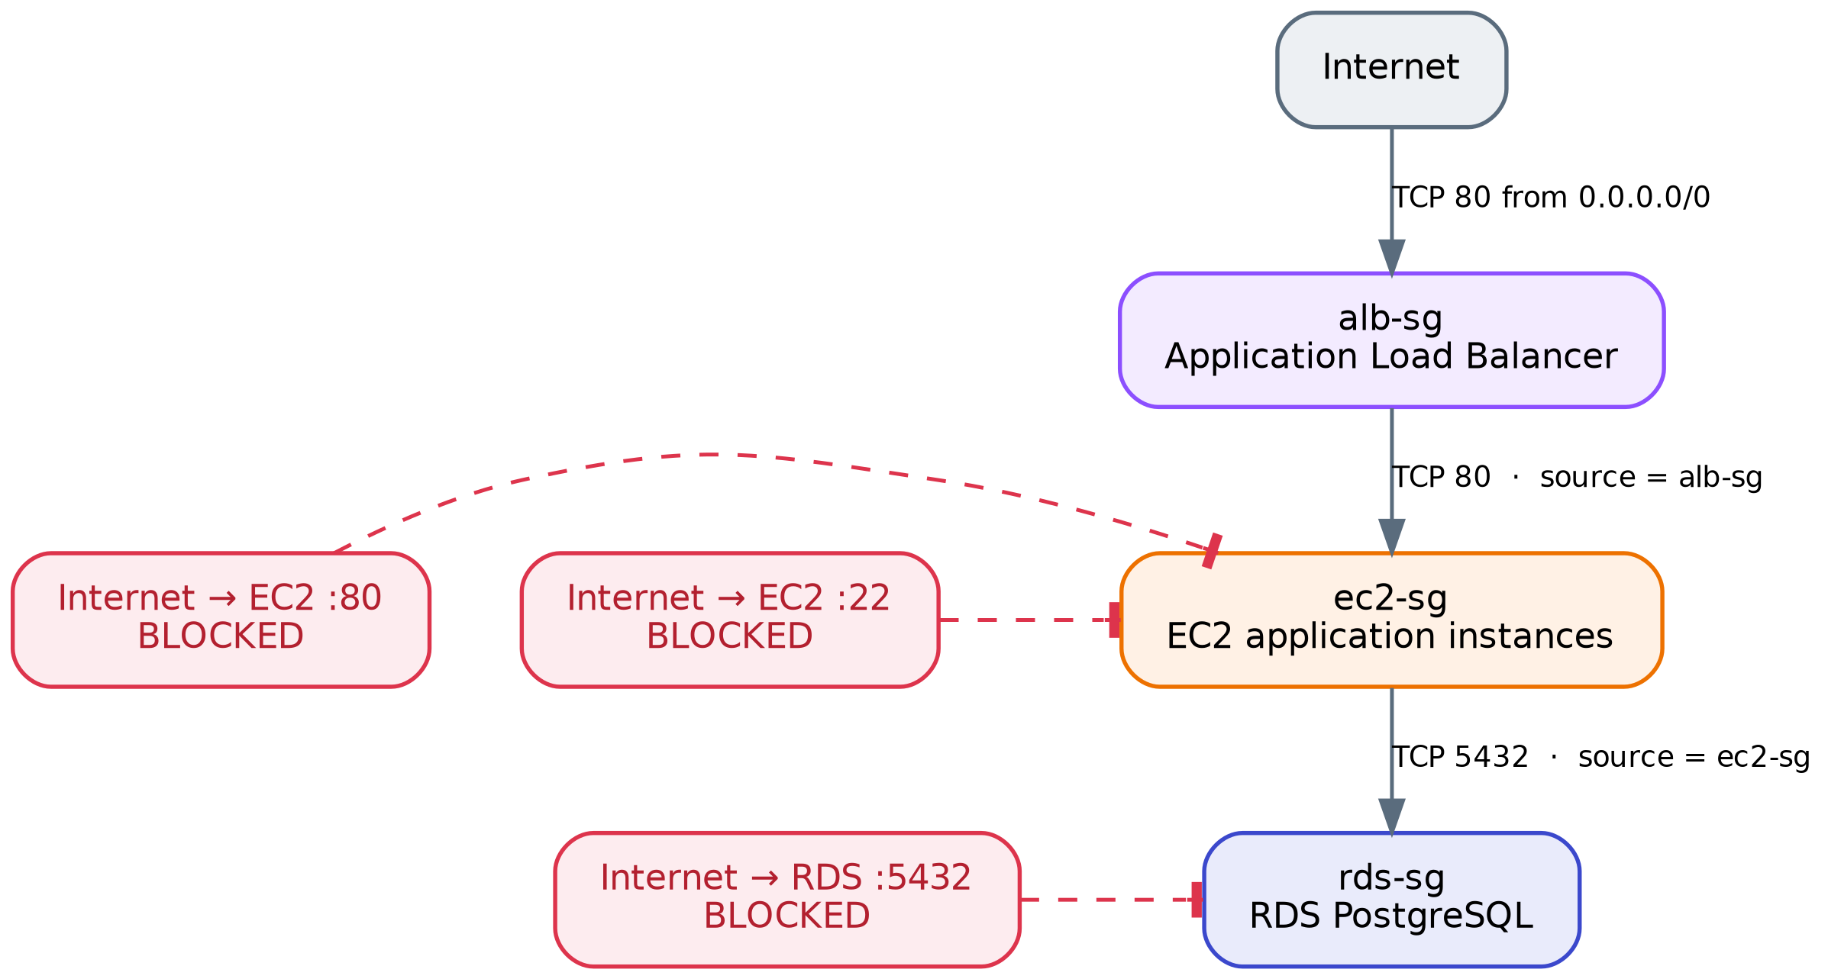
8
Security Groups
A separate firewall for each tier, chained together
WHAT I IMPLEMENTED
alb-sg allows TCP 80 from the internet into the load balancer
ec2-sg allows TCP 80 from alb-sg only — and no SSH rule at all
rds-sg allows TCP 5432 from ec2-sg only
Direct internet access to the instances and to the database is therefore blocked
WHY THIS SERVICE
Each rule references the Security Group above it instead of an IP range
Instance addresses change constantly under Auto Scaling, so an IP-based rule would be either too broad or unmaintainable
Authorisation follows group membership, so new instances are trusted automatically
Lumina Dental · NTI AWS Solutions Architect
8
Notes:
This is the clearest example of least privilege in the project.

Slide 10
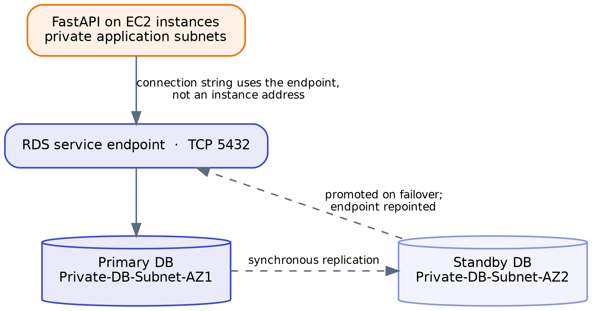
9
Amazon RDS for PostgreSQL
Moving the database off the application servers
WHAT I IMPLEMENTED
Deployed RDS PostgreSQL into the private database subnets on port 5432
Configured the application to connect through the RDS endpoint, not an instance address
Designed it as a Multi-AZ primary with a synchronised standby in the second zone
Restricted access so that only the application Security Group can connect
WHY THIS SERVICE
Backups, patching, replication and failover are handled by AWS instead of by me
Using the endpoint means a failover is transparent to the application
Keeping state in RDS is what makes the EC2 instances stateless and replaceable
Lumina Dental · NTI AWS Solutions Architect
9
Notes:
Point out that the standby carries no traffic — it exists purely so the database can be promoted.

Slide 11
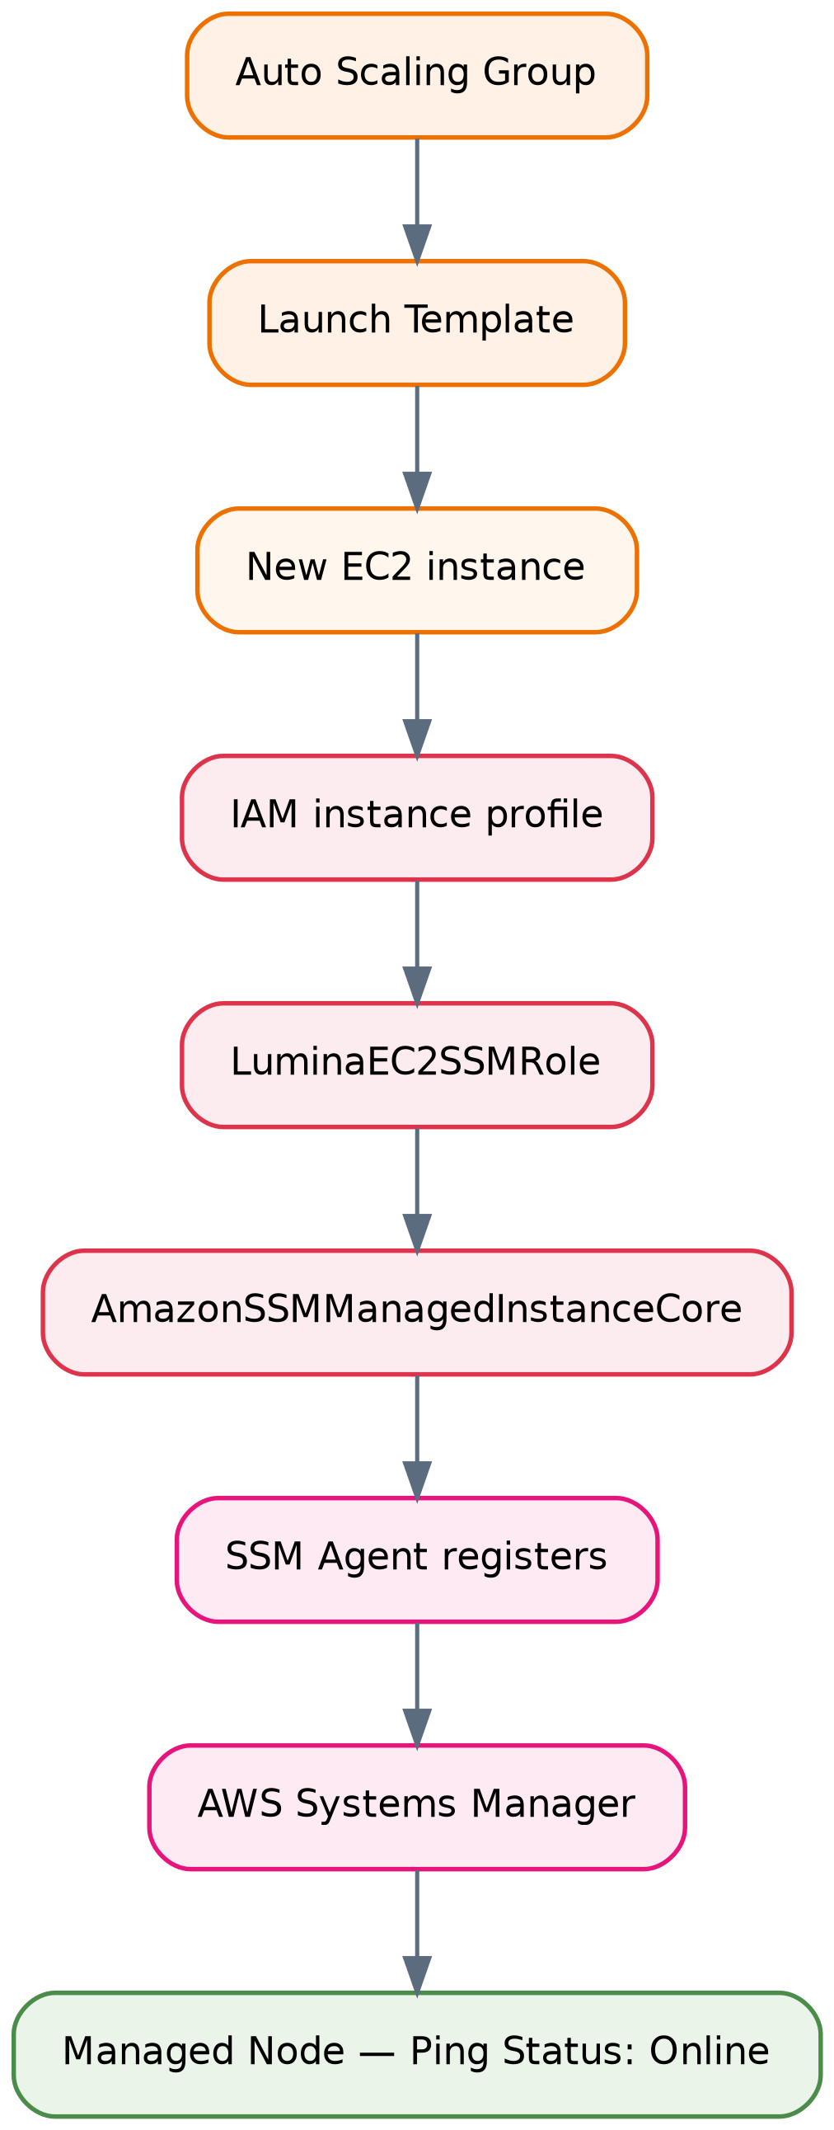
10
IAM and AWS Systems Manager
Administrative access without SSH
WHAT I IMPLEMENTED
Created the IAM role LuminaEC2SSMRole with the managed policy AmazonSSMManagedInstanceCore
Attached it through the instance profile referenced in the Launch Template
Verified the SSM Agent on the instance and confirmed it appeared as a Managed Node with status Online
Opened an interactive Session Manager shell from the console and inspected Nginx and the listening ports
WHY THIS SERVICE
No SSH port, no key pair to distribute, no public IP and no bastion host to maintain
Access is controlled by IAM, and only outbound HTTPS is required
Every instance the Auto Scaling Group launches becomes manageable automatically
Lumina Dental · NTI AWS Solutions Architect
10
Notes:
Stress the Auto Scaling angle: a manual per-instance access method simply cannot work here.

Slide 12
11
EC2 Launch Template
The single definition of how an instance is built
WHAT I IMPLEMENTED
WHY I CHOSE THIS SERVICE
Created a Launch Template based on the Golden AMI
Set the instance type to t3.small and attached the application Security Group ec2-sg
Attached the IAM instance profile carrying the role LuminaEC2SSMRole
Left subnet placement to the Auto Scaling Group so instances spread across both zones
Horizontal scaling only means something if instance number two is identical to instance number one
It is the one place where AMI, instance type, security group and permissions are defined together
Every instance the Auto Scaling Group creates inherits the same configuration automatically
Updating the application later is a new template version, not a manual change on each server
Lumina Dental · NTI AWS Solutions Architect
11
Notes:
The Launch Template is the source of truth for instance configuration.

Slide 13
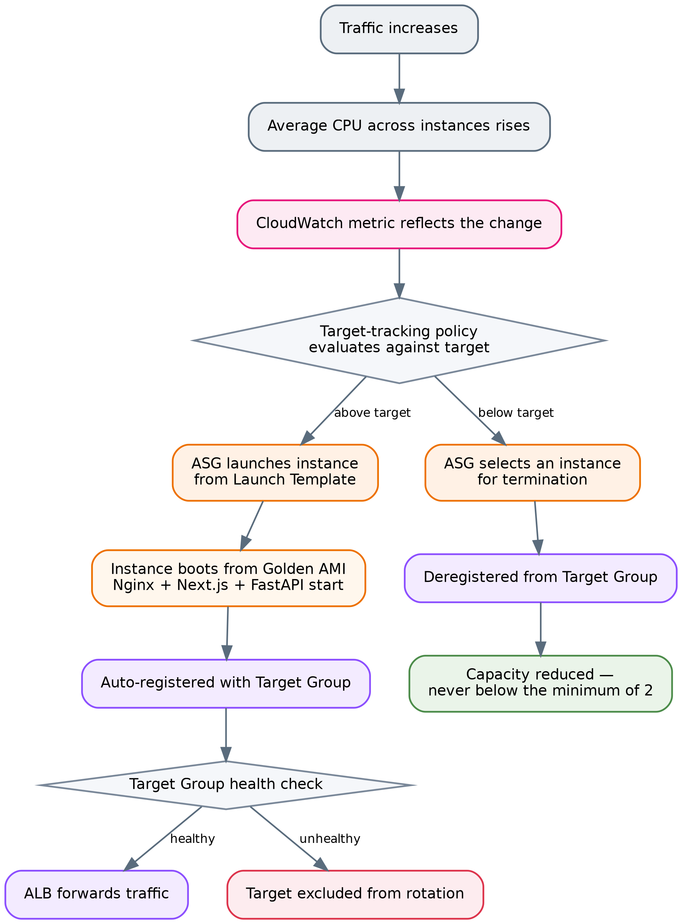
12
EC2 Auto Scaling Group
Maintaining capacity and replacing failures automatically
WHAT I IMPLEMENTED
Created the Auto Scaling Group across both private application subnets
Set minimum 2, desired 2 and maximum 6 instances
Attached it to the ALB Target Group so registration is automatic
Added a target-tracking scaling policy based on CPU utilisation
WHY THIS SERVICE
A minimum of 2 means a single instance failure is a capacity event, not an outage
It replaces failed instances by itself the compute layer becomes self-healing
The maximum of 6 puts a firm ceiling on both capacity and cost
Lumina Dental · NTI AWS Solutions Architect
12
Notes:
Walk through the diagram: metric rises, policy evaluates, instance launches, health check passes, ALB starts sending traffic.

Slide 14
13
Application Load Balancer and Target Group
The single public entry point of the application
WHAT I IMPLEMENTED
WHY I CHOSE THIS SERVICE
Created an internet-facing Application Load Balancer across both Availability Zones
Configured an HTTP listener on port 80 forwarding to the application Target Group
Created the Target Group with target type instance, protocol HTTP on port 80, and health checks enabled
HTTPS was not configured, because a public certificate requires a domain name (see the Route 53 slide)
It gives the application one stable address that does not depend on any individual instance
Health checks stop traffic reaching a broken instance within seconds, before any replacement happens
Because users talk to the ALB, the EC2 instances can stay completely private
Working at Layer 7 means it understands HTTP, which is what allows path-based health checks and future TLS termination
Lumina Dental · NTI AWS Solutions Architect
13
Notes:
The ALB, the Target Group and the ASG are decoupled: the ALB routes, the Target Group tracks health, the ASG manages instances.

Slide 15
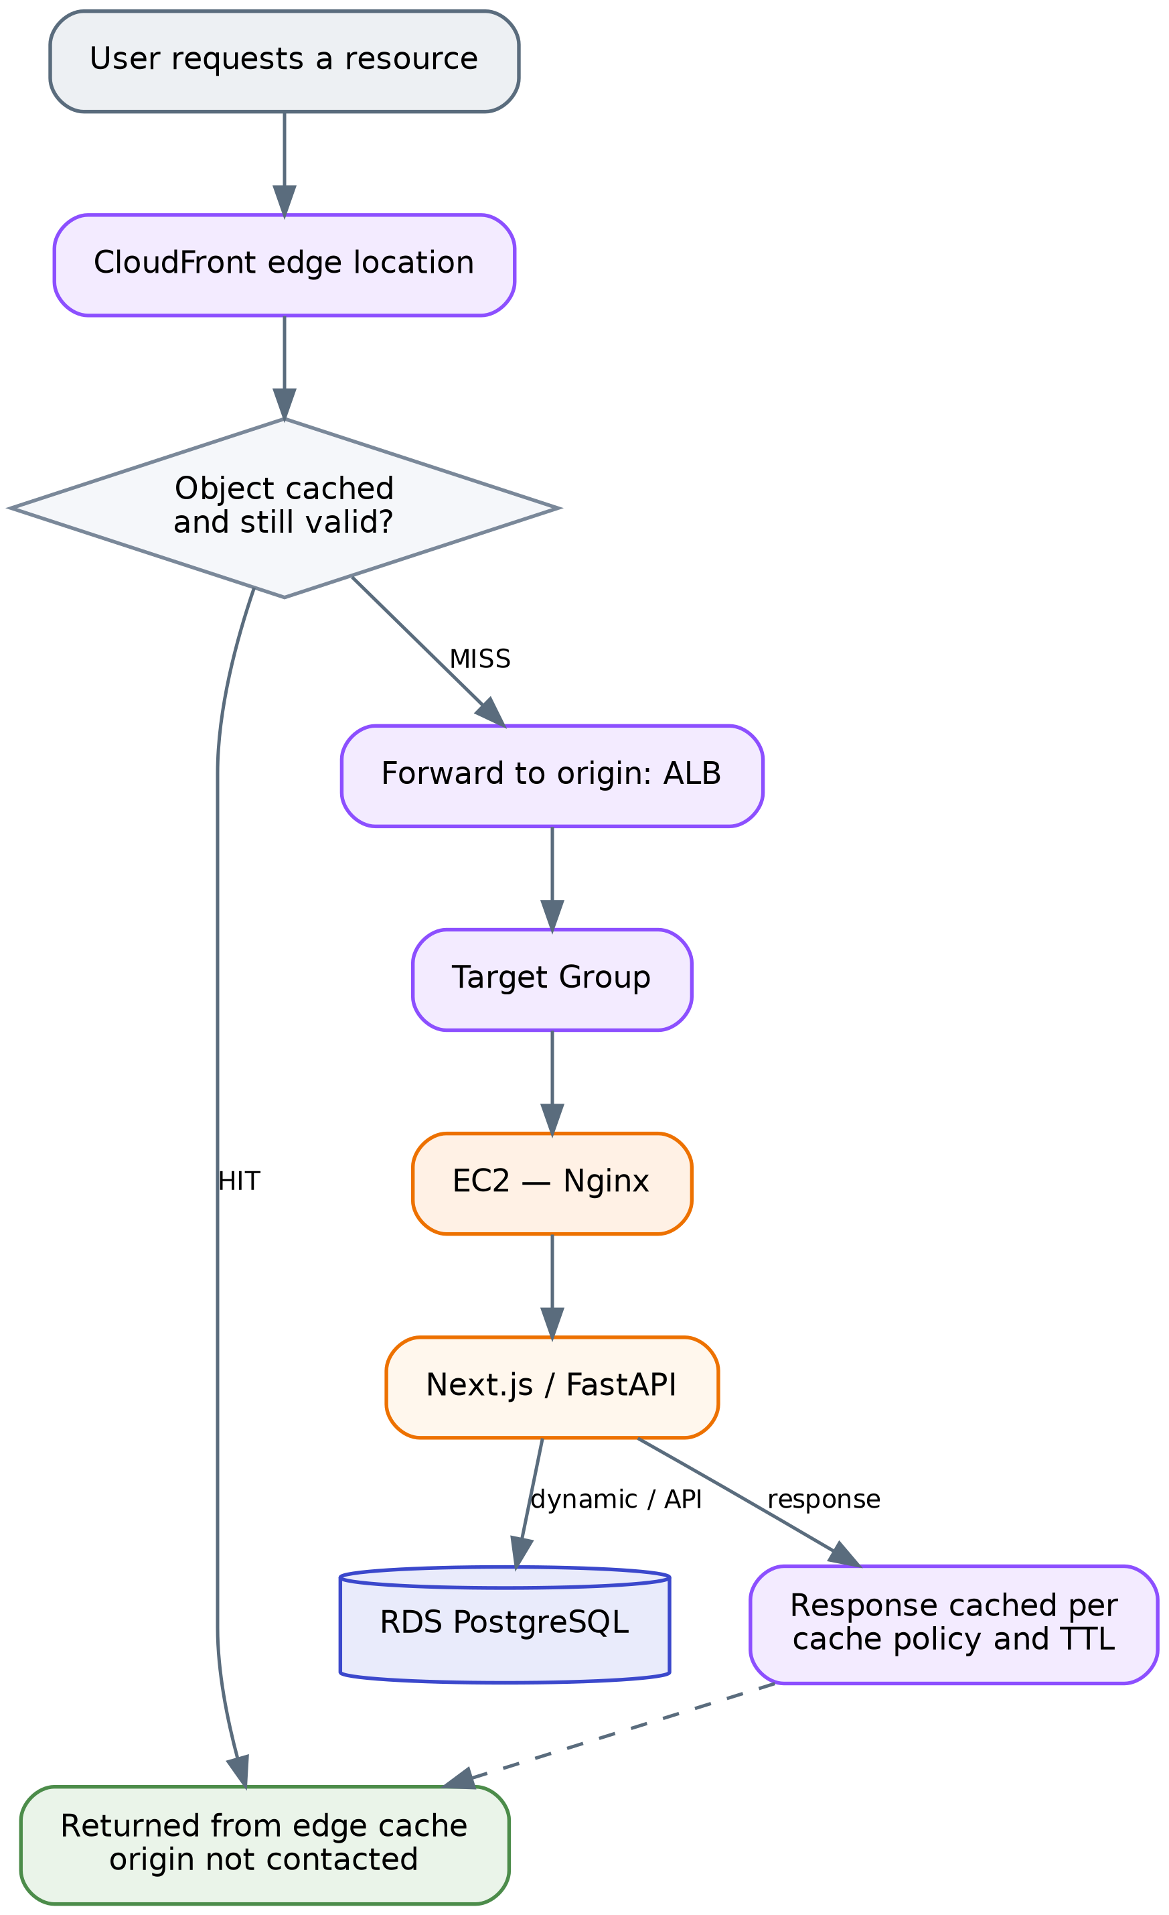
14
Amazon CloudFront
Serving static content from the edge
WHAT I IMPLEMENTED
Created a distribution with the Application Load Balancer as its origin
Cached static assets JavaScript, CSS, images and fonts at the edge locations
Left dynamic pages and /api/ requests to pass through to the origin
CloudFront never talks to the EC2 instances directly; it always goes through the ALB
WHY THIS SERVICE
Static assets are served closer to the user, which reduces latency
Cached requests never reach the ALB or the instances, freeing capacity for real work
API responses depend on the user and the database, so caching them would return stale or wrong data
Lumina Dental · NTI AWS Solutions Architect
14
Notes:
Explain the hit/miss path shown in the diagram.

Slide 16
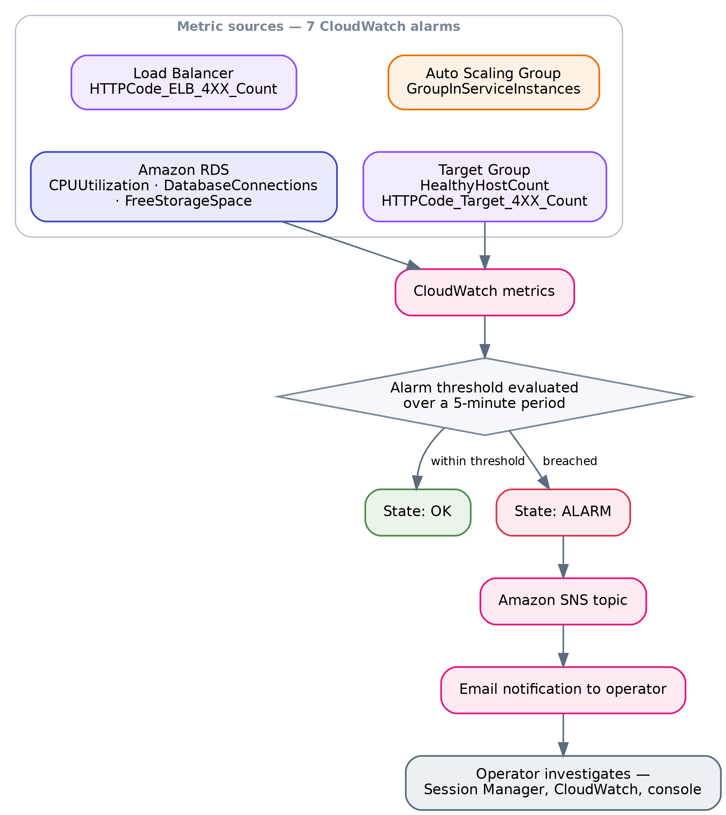
15
Amazon CloudWatch and SNS
Knowing when something goes wrong
WHAT I IMPLEMENTED
Configured seven alarms on a five-minute period across four services
Auto Scaling Group: in-service instances below 2. Target Group: healthy hosts below 2
Load balancer and targets: more than five 4XX responses in five minutes
RDS: CPU above 80%, connections above 80, free storage below 2 GB
Subscribed every alarm to an SNS topic that delivers email notifications
WHY THIS SERVICE
Alarms are set on group-level metrics, so they survive instances being replaced
In-service count and healthy host count detect two genuinely different failures
SNS turns an alarm state change into something a person actually sees
Lumina Dental · NTI AWS Solutions Architect
15
Notes:
Explain why an alarm on a specific instance would break the moment Auto Scaling replaced it.

Slide 17
16
AWS WAF
Inspecting requests before they reach the application
WHAT I IMPLEMENTED
WHY I CHOSE THIS SERVICE
Created a Web ACL combining four AWS managed rule groups: Common, SQL injection, Admin Protection and Anti-DDoS
Added custom rules: IPv4 and IPv6 allow and block lists, a geographic restriction, a global rate-based rule and a body-size rule
Tested it: a request to /admin returned HTTP 403, traced through sampled requests to the rule AdminProtection_URIPATH
Observed a real internet scanner reaching the public endpoint, confirming WAF inspects live traffic
Security Groups filter by address and port; WAF is the only layer that understands the request itself
SQL injection protection matters directly here, because the backend talks to a PostgreSQL database
AWS-managed rule groups stay updated without me writing attack signatures
Lumina Dental · NTI AWS Solutions Architect
16
Notes:
Be honest that three rules currently count rather than block — that is a deliberate, temporary tuning stage.

Slide 18
17
Amazon Route 53 and HTTPS
Designed and documented, but deliberately not deployed
Status: planned, not implemented — no domain name was purchased, so no public certificate could be issued.
WHAT THE DESIGN CALLS FOR
WHY IT BELONGS IN THE DESIGN
A Route 53 hosted zone for the purchased domain
An Alias A record pointing the root domain straight at the Application Load Balancer
A public ACM certificate validated by DNS
An HTTPS listener on port 443 with the certificate attached to the ALB
The port 80 listener changed to redirect to HTTPS
An Alias record can point a root domain at an AWS resource, which a normal CNAME cannot
Terminating TLS at the load balancer means the certificate is managed in one place, not on every instance
That matters here because Auto Scaling creates and destroys instances continuously
The application currently runs over HTTP, which is the most important gap left in the project
Lumina Dental · NTI AWS Solutions Architect
17
Notes:
Being explicit about what was not built is part of an honest architecture review.

Slide 19
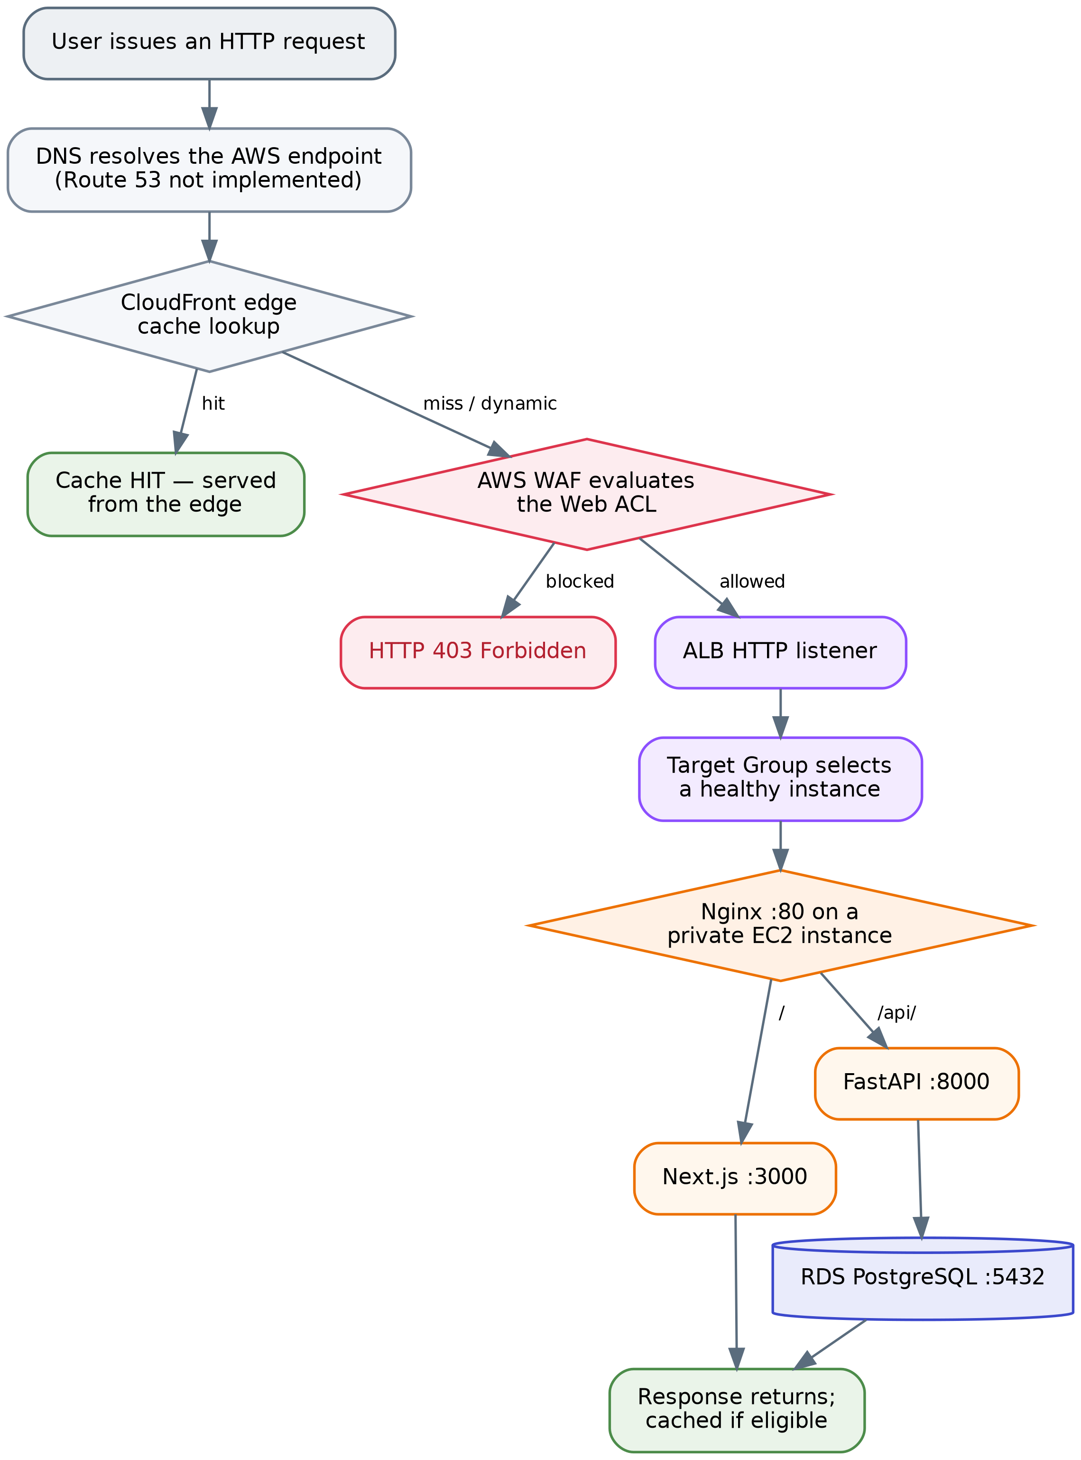
18
End-to-end request flow
How one user request travels through the whole system
THE PATH IN WORDS
CloudFront answers immediately if the asset is already cached at the edge
Otherwise WAF inspects the request and can block it with a 403
The ALB listener forwards the request to the Target Group
The Target Group picks a healthy private instance
Nginx sends / to Next.js and /api/ to FastAPI
FastAPI queries RDS over port 5432 inside the VPC
The response returns along the same path and may be cached
Lumina Dental · NTI AWS Solutions Architect
18
Notes:
This slide ties every previous service together into one journey.

Slide 20
19
What happens when something fails
The architecture is judged by how it behaves on a bad day
An instance fails
A whole zone fails
The database fails
Health checks fail and the ALB stops sending it traffic
The healthy instance keeps serving users
The Auto Scaling Group launches a replacement from the AMI
Alarms notify me by email throughout
The load balancer serves from the surviving zone
Auto Scaling can launch instances there
That zone has its own NAT Gateway, so outbound access survives
Capacity is halved, but the service stays up
RDS promotes the standby in the other zone
The endpoint is repointed to the new primary
The application reconnects without a configuration change
There is a short interruption during the failover
Lumina Dental · NTI AWS Solutions Architect
19
Notes:
Each failure is handled by a different service, which is exactly why the layers are separated.

Slide 21
20
Limitations and what I would do next
An honest assessment of the current deployment
CURRENT LIMITATIONS
PLANNED IMPROVEMENTS
Traffic runs over HTTP no domain, so no TLS certificate
No centralised logging: logs disappear with the instance that produced them
The database is a single writable primary it does not scale horizontally
Deployment is manual: build an AMI, version the template, replace the instances
Buy a domain, add Route 53 and an ACM certificate, and move to HTTPS
Send Nginx, application and ALB access logs to CloudWatch Logs and S3
Add RDS Proxy for connection pooling and ElastiCache for repeated reads
Define the infrastructure as code and automate the release with a pipeline
Lumina Dental · NTI AWS Solutions Architect
20
Notes:
Knowing the limits of your own design is part of the architect role.

Slide 22
In summary
A single-server application was rebuilt as a layered AWS architecture: stateless compute behind a load balancer, a managed database in isolated subnets, security enforced at every tier, and monitoring that reports failures before users do.
12
2
2 – 6
7
AWS services used
Availability Zones
instances, automatically
CloudWatch alarms
Thank you — questions are welcome
Zeyad Bilal Gamal · Benha University, Faculty of Engineering in Shoubra
Notes:
Close by restating the objective and inviting questions.

